Slide 1
mySql syntax
Week 9

Slide 2
Create database named library
CREATE DATABASE library;

Slide 3
Drop database
DROP DATABASE library;

Slide 4
BACKUP DATABASE
BACKUP DATABASE databasename TO DISK = 'filepath';

Slide 5
Example
BACKUP DATABASE testDB TO DISK = 'D:\backups\testDB.bak';

Slide 6
CREATE TABLE
CREATE TABLE table_name ( column1 datatype, column2 datatype, column3 datatype, .... );

Slide 7
Example
CREATE TABLE Persons ( PersonID int, LastName varchar(255), FirstName varchar(255), Address varchar(255), City varchar(255) );

Slide 8
DROP TABLE
DROP TABLE Person;

Slide 9
TRUNCATE TABLE
TRUNCATE TABLE Person;
The TRUNCATE TABLE statement is used to delete the data inside a table, but not the table itself.

Slide 10
ALTER TABLE
The ALTER TABLE statement is used to add, delete, or modify columns in an existing table.
The ALTER TABLE statement is also used to add and drop various constraints on an existing table.

Slide 11
Example1
ALTER TABLE table_name ADD column_name datatype;
ALTER TABLE Person ADD Email varchar(255);

Slide 12
Example 2
ALTER TABLE Persons DROP COLUMN Email;

Slide 13
Example 3
ALTER TABLE table_name ALTER COLUMN column_name datatype;

Slide 14
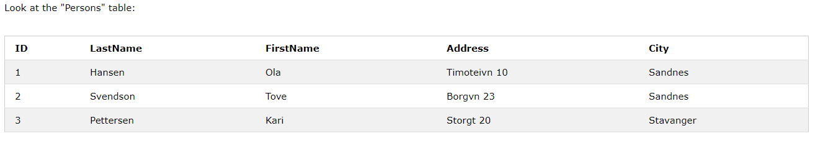

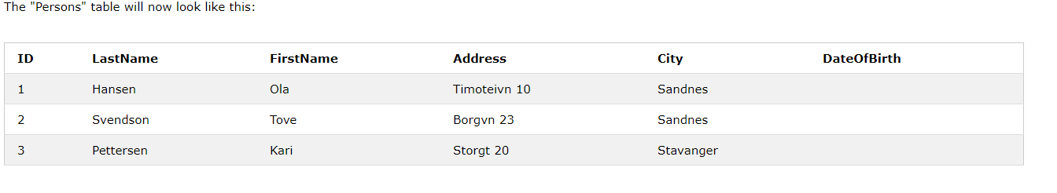
Real example

Slide 15
Change Data Type Example
ALTER TABLE Persons ALTER COLUMN DateOfBirth year;

Slide 16
SQL Create Constraints
CREATE TABLE table_name ( column1 datatype constraint, column2 datatype constraint, column3 datatype constraint, .... );

Slide 17
SQL Constraints
SQL constraints are used to specify rules for the data in a table.
Constraints are used to limit the type of data that can go into a table. This ensures the accuracy and reliability of the data in the table. If there is any violation between the constraint and the data action, the action is aborted.
Constraints can be column level or table level. Column level constraints apply to a column, and table level constraints apply to the whole table.
The following constraints are commonly used in SQL:
NOT NULL - Ensures that a column cannot have a NULL value
UNIQUE - Ensures that all values in a column are different
PRIMARY KEY - A combination of a NOT NULL and UNIQUE. Uniquely identifies each row in a table
FOREIGN KEY - Uniquely identifies a row/record in another table
CHECK - Ensures that all values in a column satisfies a specific condition
DEFAULT - Sets a default value for a column when no value is specified
INDEX - Used to create and retrieve data from the database very quickly

Slide 18

SQL NOT NULL Constraint
By default, a column can hold NULL values.
CREATE TABLE Persons ( ID int NOT NULL, LastName varchar(255) NOT NULL, FirstName varchar(255) NOT NULL, Age int );

Slide 19
UNIQUE Constraint
The UNIQUE constraint ensures that all values in a column are different.
Both the UNIQUE and PRIMARY KEY constraints provide a guarantee for uniqueness for a column or set of columns.
A PRIMARY KEY constraint automatically has a UNIQUE constraint.

Slide 20
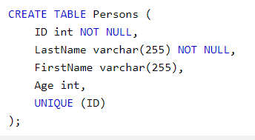
Example

Slide 21
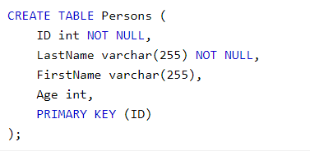
PRIMARY KEY Constraint
The PRIMARY KEY constraint uniquely identifies each record in a table.
Primary keys must contain UNIQUE values, and cannot contain NULL values.
A table can have only one primary key, which may consist of single or multiple fields.

Slide 22

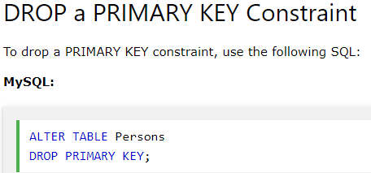
Alter

Slide 23
SQL FOREIGN KEY Constraint
FOREIGN KEY is a key used to link two tables together.
A FOREIGN KEY is a field (or collection of fields) in one table that refers to the PRIMARY KEY in another table.
The table containing the foreign key is called the child table, and the table containing the candidate key is called the referenced or parent table.
Look at the following two tables:

Slide 24
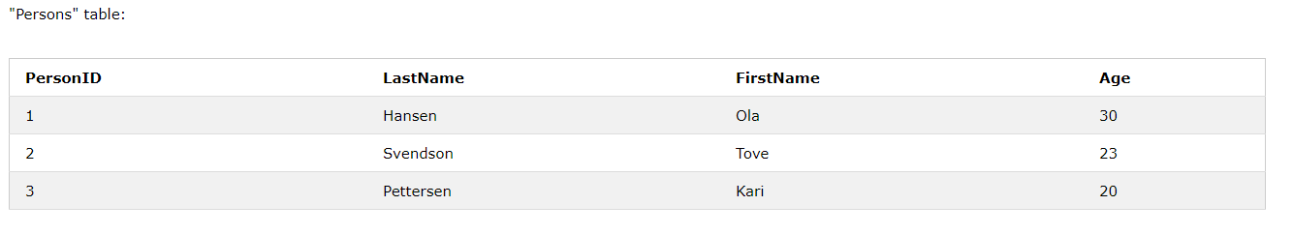
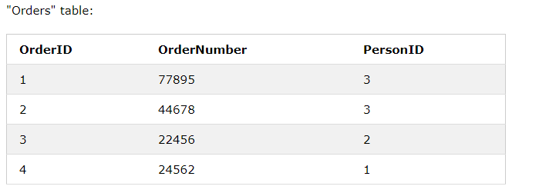

Slide 25
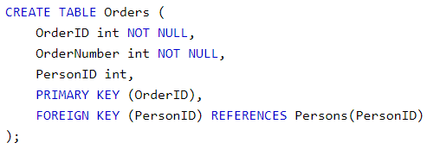
Commands

Slide 26
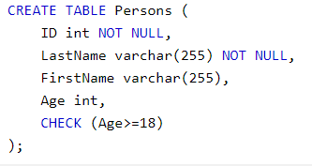
CHECK Constraint

Slide 27
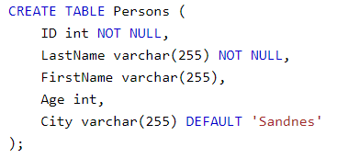
DEFAULT Constraint

Slide 28
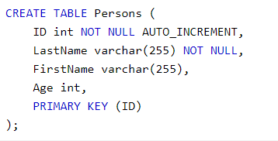

AUTO INCREMENT Field
To start with an AUTO_INCREMENT value other than 1, set that value with CREATE TABLE or ALTER TABLE, like this:

Slide 29
SQL Dates (data type)
MySQL comes with the following data types for storing a date or a date/time value in the database:
DATE - format YYYY-MM-DD
DATETIME - format: YYYY-MM-DD HH:MI:SS
TIMESTAMP - format: YYYY-MM-DD HH:MI:SS
YEAR - format YYYY or YY
SQL Server comes with the following data types for storing a date or a date/time value in the database:
DATE - format YYYY-MM-DD
DATETIME - format: YYYY-MM-DD HH:MI:SS
SMALLDATETIME - format: YYYY-MM-DD HH:MI:SS
TIMESTAMP - format: a unique number

Slide 30
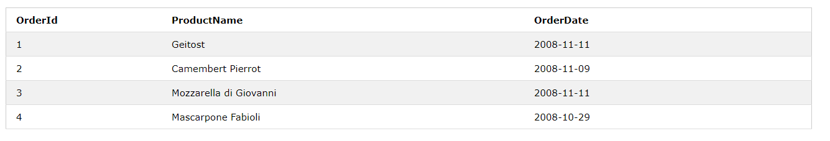
We use the following SELECT statement:

Slide 31
references
https://www.w3schools.com/sq

